Slide 1
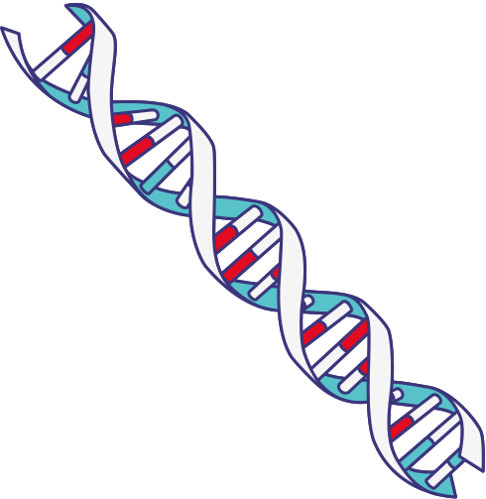
TRANSCRIPTION
Group 2

Slide 2
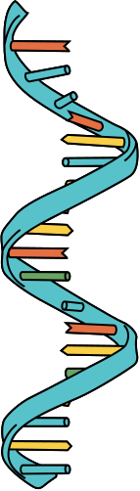
RNA: DNA’S CLOSE COUSIN
IS COMPOSED OF:
Ribose sugar
Four nucleotide bases (Adenine, Guanine, Cytosine & Uracil)
Phosphate

Slide 3
RNA: MAJOR CHARACTERISTICS
is very unstable and decomposes rapidly
contains uracil in place of thymine.
is almost always single-stranded.

Slide 4
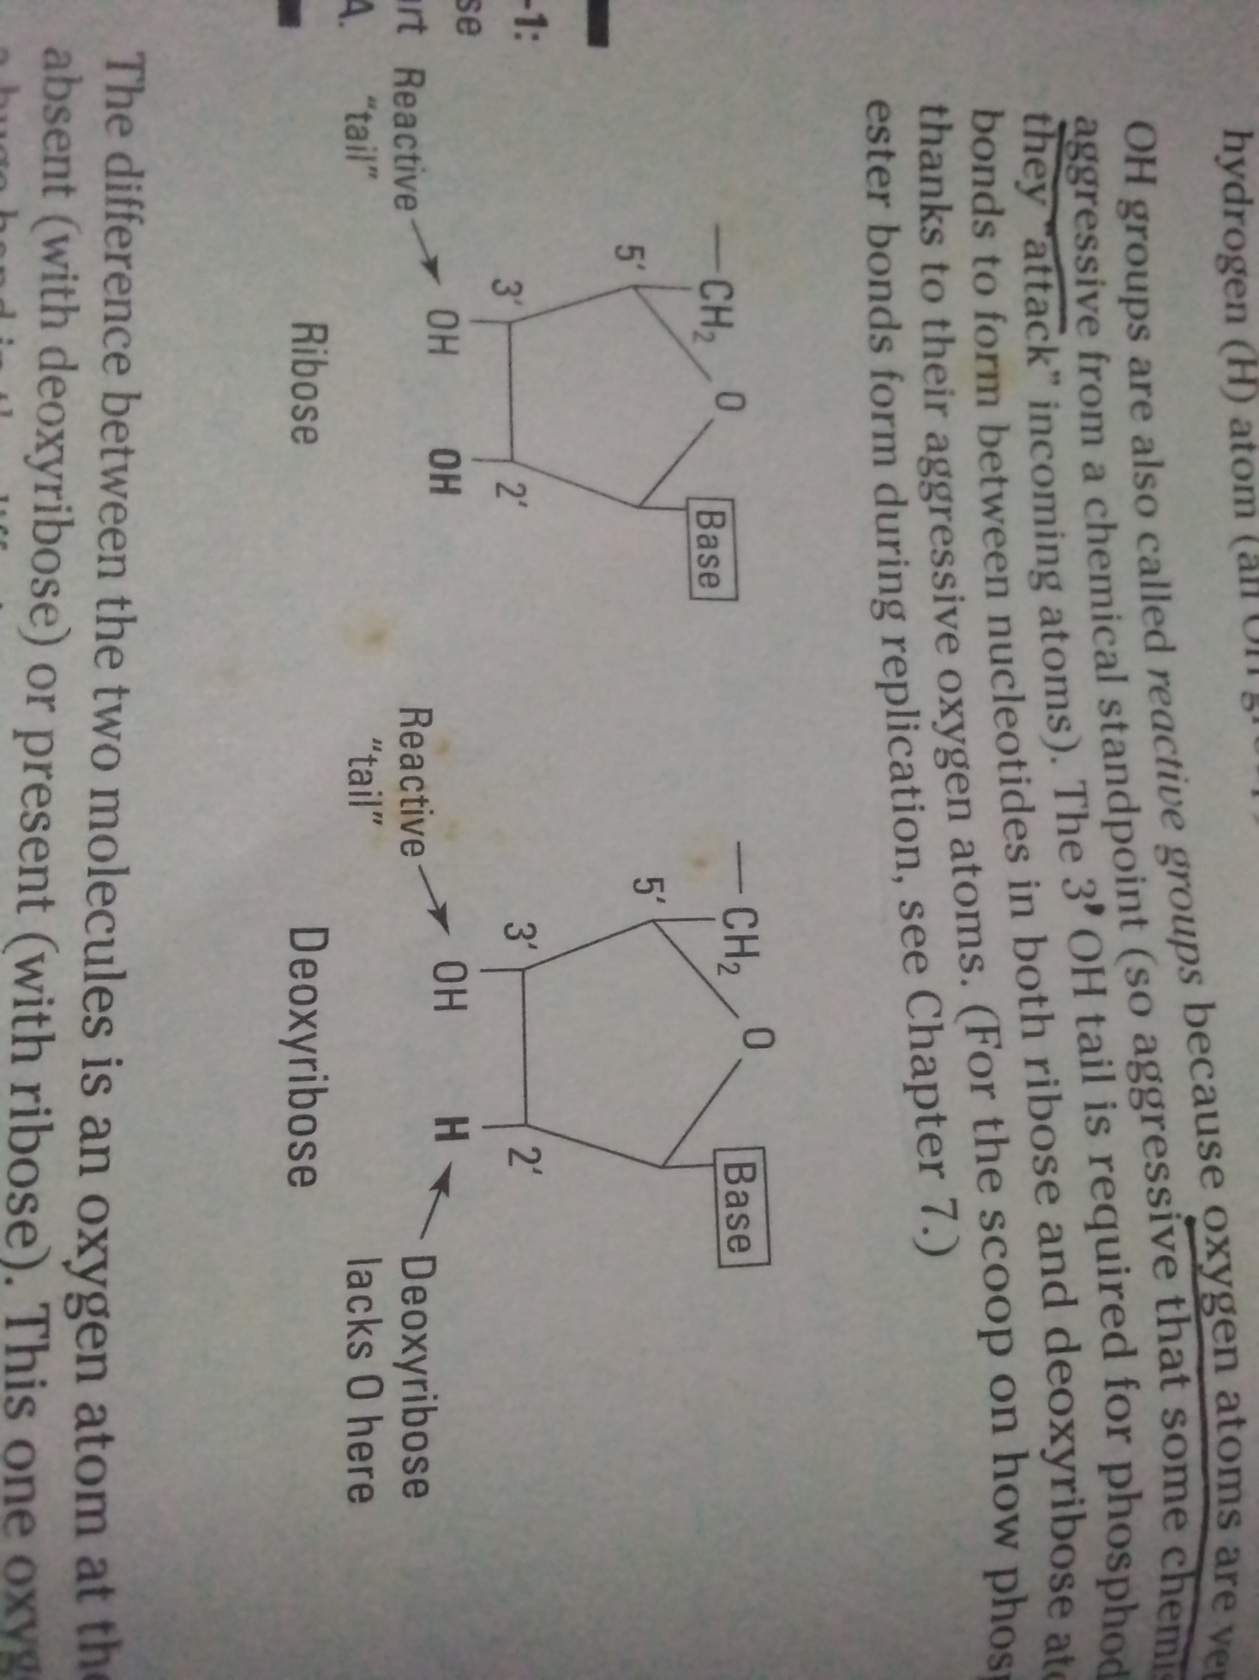
USING A SLIGHTLY DIFFERENT SUGAR
DNA: Must be protected from decomposition.
The absence of one oxygen atom is part of the key to extending DNA’s longetivity.
RNA: easily decomposes because its reactive 2' OH tail introduces RNA into chemical interactions that break up the molecule.

Slide 5
TRANSCRIPTION
is the process by which genetic information in DNA is copied into RNA.
KEY STEPS:
Initiation: RNA polymerase binds to the
promoter region.
Elongation: RNA polymerase synthesizes RNA from the DNA
template.
Termination: Transcription ends when RNA polymerase
reaches a termination signal.

Slide 6
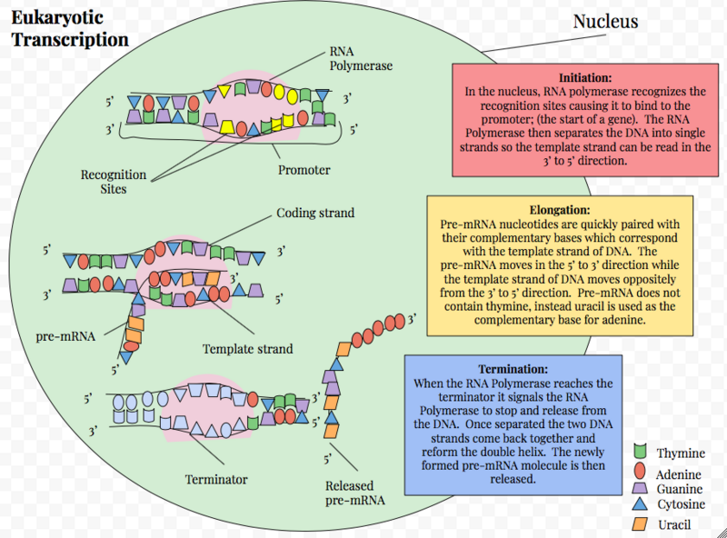
TRANSCRIPTION
In eukaryotes, the RNA is further processed (capping, splicing, tailing) before translation.

Slide 7
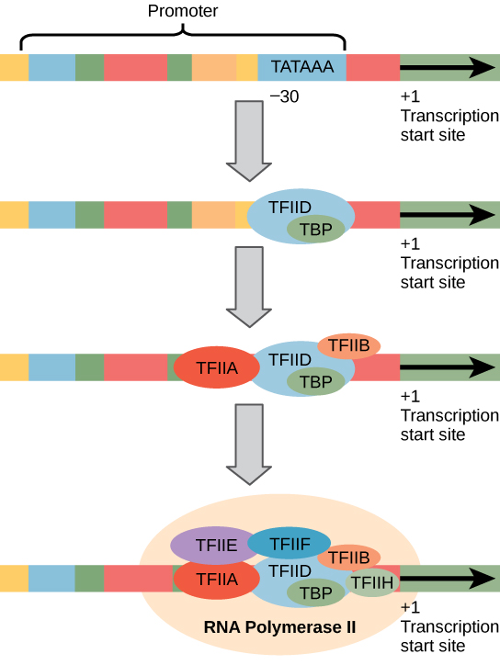
INITIATION
Chromatin Remodeling
DNA unwinds from histones to make the gene accessible.
Formation of the Pre-Initiation Complex (PIC)
General transcription factors (GTFs) bind to the promoter region, particularly the TATA box.
TATA-binding protein (TBP) within TFIID recognizes the TATA box.
Recruitment of RNA Polymerase II
RNA Polymerase II binds to the DNA with help from additional transcription factors (e.g., TFIIB, TFIIE, TFIIF).
Forms a stable complex with the promoter.

Slide 8
INITIATION
Transcription Bubble Formation
Helicase activity in TFIIH unwinds DNA, creating a bubble at the start site.
Start of RNA Synthesis
RNA Polymerase II begins RNA synthesis by adding RNA nucleotides complementary to the DNA template strand.
After a few nucleotides are synthesized, RNA Polymerase II escapes the promoter and begins elongation.

Slide 9
THE THREE EUKARYOTIC RNA POLYMERASES (RNAPS)
RNA polymerase I is located in the nucleolus, a specialized nuclear substructure in which ribosomal RNA (rRNA) is transcribed, processed, and assembled into ribosomes.
RNA polymerase II is located in the nucleus and synthesizes all protein-coding nuclear pre-mRNAs. Eukaryotic pre-mRNAs undergo extensive processing after transcription, but before translation.
RNA polymerase III is also located in the nucleus. This polymerase transcribes a variety of structural RNAs that includes the 5S pre-rRNA, transfer pre-RNAs (pre-tRNAs), and small nuclear pre-RNAs.

Slide 10
TRANSCRIPTION

Slide 11
TRANSCRIPTION
In eukaryotes, the RNA is further processed (capping, splicing, tailing) before translation.

Slide 12
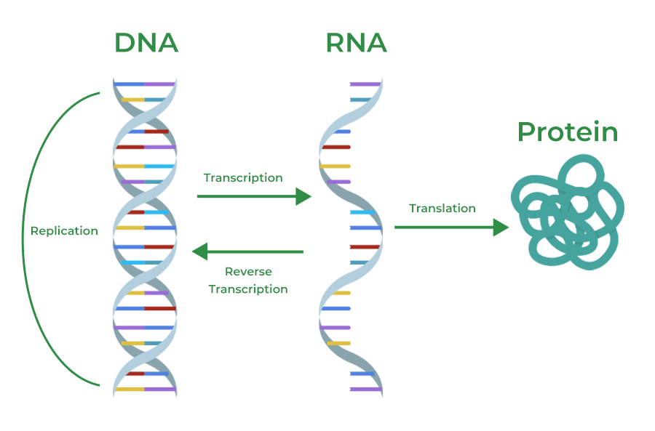
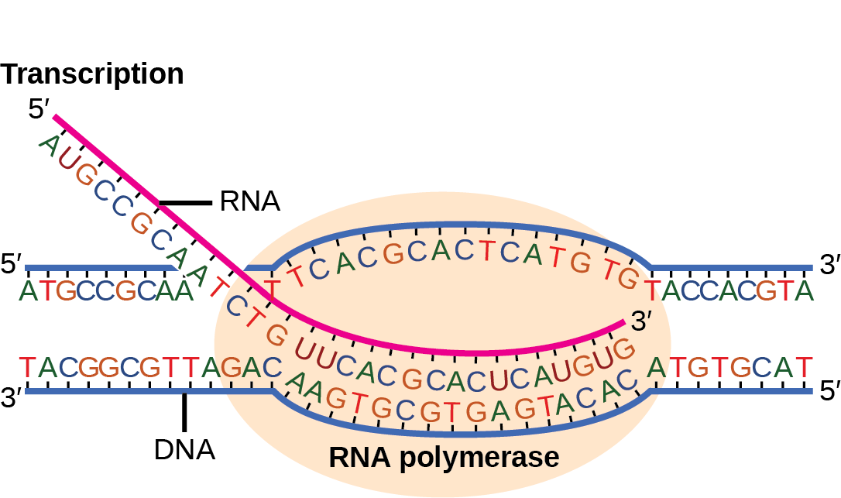
RNA MODIFICATION
In eukaryotes, the RNA is further processed (capping, splicing, tailing) before translation.

Slide 13
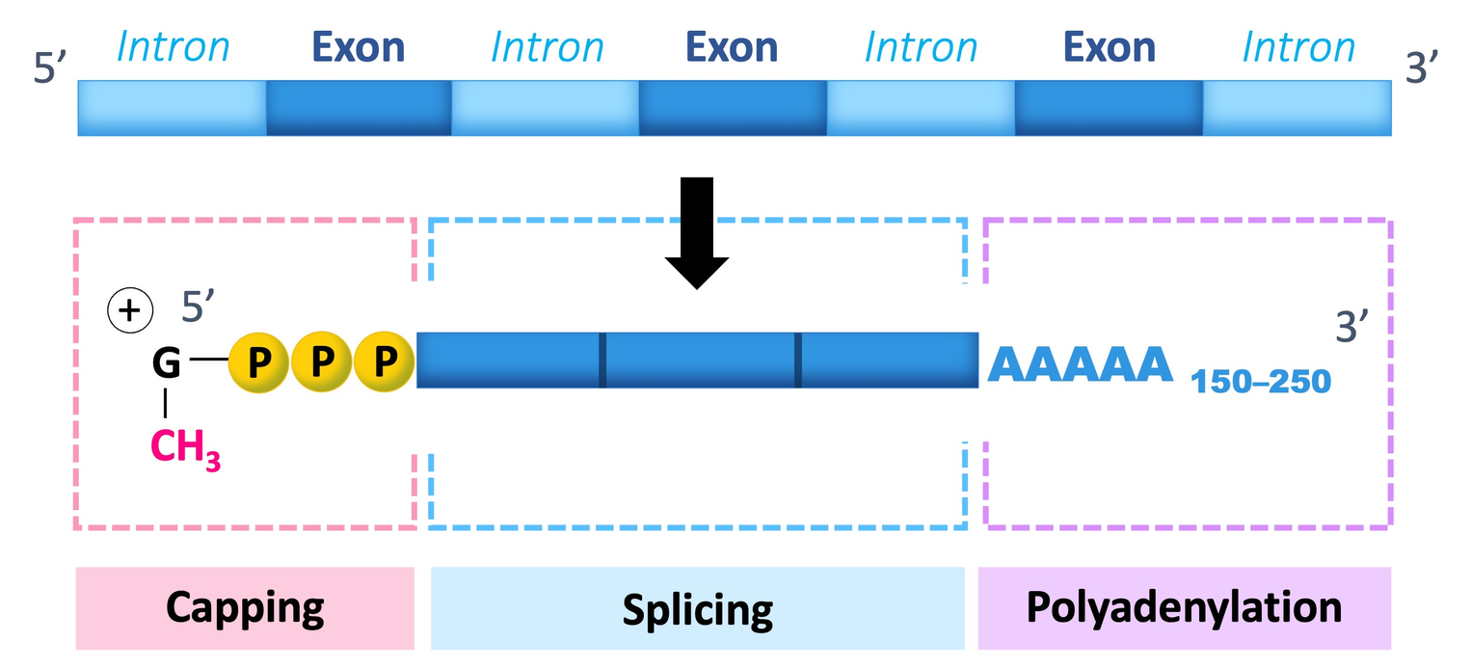
MAJOR RNA MODIFICATION
5’ Capping
3’ Polyadenylation
Splicing

Slide 14
5' CAPPING
Addition of a modified guanine nucleotide to the 5' end of the pre-mRNA.
Function: Protects mRNA from degradation and aids in ribosome recognition.
Process:
- Occurs shortly after transcription starts.
- Enzyme adds a “cap” structure to the first nucleotide at the 5' end.

Slide 15
3’ Polyadenylation
Addition of a long chain of adenine nucleotides, called a poly-A tail, to the 3' end of the pre-mRNA.
Function: Increases mRNA stability and aids in nuclear export.
Process:
- Enzymes recognize the polyadenylation signal sequence in the mRNA.
- A poly-A tail (typically 50-250 adenines) is added.

Slide 16
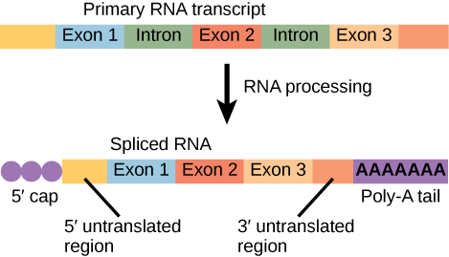
SPLICING
Removal of non-coding regions (introns) from the pre-mRNA.
Function: Joins coding regions (exons) to create a continuous sequence for translation.
Process:
- Carried out by a complex called the spliceosome.
- Introns are cut out, and exons are joined together.

Slide 17
Nuclear export relies on these modifications because they act as "signals" that the RNA is ready and safe to enter the cytoplasm for protein synthesis.

Slide 18
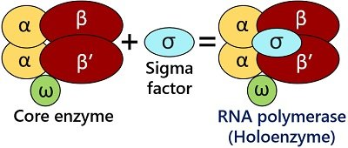
TRANSCRIPTION
In bacteria, transcription involves a simpler process, as there is no nuclear membrane.
5 subunits:
Beta prime
Beta
alpha 1
alpha 2
omega

Slide 19
FUNCTION
α Subunits: Involved in enzyme assembly and interaction with regulatory proteins.
β and β' Subunits: Form the active center; essential for RNA chain initiation and elongation.
ω Subunit: Stabilizes the enzyme and facilitates assembly of the core enzyme.

Slide 20
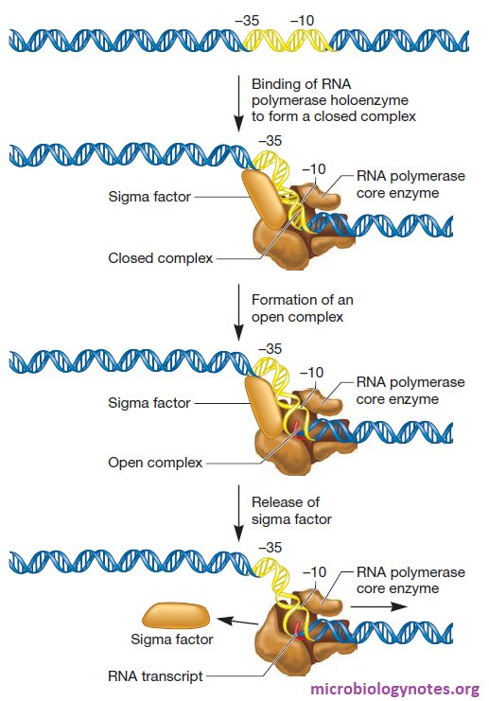

Slide 23
TRANSCRIPTION
Steps in Bacteria:
- RNA polymerase binds to the promoter with the help of sigma factor.
- RNA synthesis starts at the transcription start site.
- Elongation occurs as RNA polymerase moves along the template strand.
- Termination occurs through either Rho-dependent or Rho-independent signals.

Slide 24
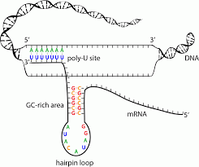
RHO-INDEPENDENT
The hairpin structure physically destabilizes the RNA-DNA hybrid, while the weak U-A pairing between RNA and DNA further reduces stability.
Add a little bit of body text

Slide 25
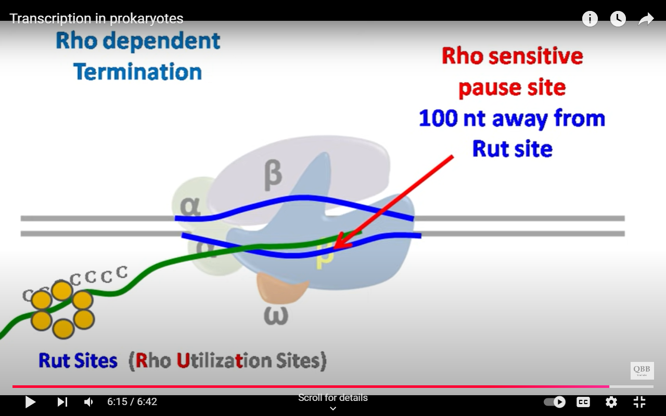
RHO-DEPENDENT
During transcription, Rho binds to a specific RNA sequence called the Rho utilization site (rut site), located on the RNA transcript.
it unwinds the RNA-DNA hybrid, causing the RNA transcript to detach. This effectively halts transcription, releasing the newly made RNA molecule.
Add a little bit of body text

Slide 26
TRANSCRIPTION
Key Steps in Eukaryotes:
- Transcription factors and RNA polymerase II bind to the promoter (TATA box).
- Elongation involves RNA polymerase II synthesizing RNA.
- A 5' cap is added as elongation proceeds.
- Termination occurs at the polyadenylation signal.
- The RNA is spliced, capped, and a poly(A) tail is added before export.

Slide 27
Thank you...

